Slide 1
Tomato Leaf Disease
Detection Using
Ensemble CNN Model
GUIDE NAME
MRS.LINCY JEMINA M.E (PH.D)
DEPARTMENT OF CSE
PANIMALAR ENGINERING COLLEGE,
CHENNAI
PRESENTED BY:
GOKUL.E(211423104174)
HARIKRISHNAA.S(211423104200)

Slide 2
THANK YOU FOR YOU GUIDENCE
PROJECT CO-ORDINATORS
DR. P.DEEPA , M.E, Ph.D.
ASSOCIATIVE PROFESSOR
DEPARTMENT OF CSE
PANIMALAR ENGINERING COLLEGE
Mrs. S.LINCY JEMINA M.E, (Ph.D).
ASSISTANT PROFFR
DEPARTMENT OF CSE
PANIMALAR ENGINERING COLLEGE,

Slide 3
Outline
Abstract
Introduction
Literature Review
Propsed System
Hardware Specifications
Software Specifications
System Architecture
Propsed Methodology
Results
Conclusion
Future Work

Slide 4
Abstract
This project presents a deep learning-based system for tomato leaf disease detection using an ensemble of ResNet50 and DenseNet201 CNN models. Trained on the PlantVillage Tomato dataset with 14,000 images, the system achieves 99.97% accuracy through image preprocessing and feature fusion. It identifies disease type, confidence, and treatment via an offline CLI tool, aiding farmers with early diagnosis and supporting SDG 2.4 – Sustainable Agriculture.

Slide 5
Introduction
Tomato crops suffer heavy yield loss from leaf diseases like Early and Late Blight. Manual detection is slow and unreliable, especially in rural areas. This work uses Convolutional Neural Networks (CNNs)—specifically an ensemble of ResNet50 and DenseNet201—to automatically classify tomato leaf diseases from images. The offline CLI-based tool ensures accessibility, providing accurate and rapid diagnosis to promote sustainable farming.

Slide 6
Literature survey

Slide 7
S.NO | Title of the Paper | Authors | Year | Method/ Technique | Dataset | Key Findings
1 | Using Transfer Learning Based Plant Disease Classification and Early Fusion Ensemble | Wasswa et al. | 2024 | CNN Ensemble (9 CNNs) | PlantVillage | Achieved 97.79% accuracy
2 | Tomato Disease Detection using VGG16 and Transfer Learning | Raj et al. | 2023 | VGG16 | Tomato Dataset | ~95% accuracy
3 | Mobile Leaf Classification using MobileNet + SVM | Arora et al. | 2022 | MobileNet + SVM | Custom Mobile Dataset | Lightweight, mobile friendly
4 | Deep Learning for Plant Disease Detection: A Review | Singh et al. | 2021 | Review of CNNs | Multiple datasets | Summarized CNN advantages & limits
5 | Real-Time Plant Disease Detection using YOLOv5 | Patel et al. | 2022 | YOLOv5 | Tomato & chili dataset | Fast detection, GPU dependent

Slide 8
6 | LightMixer: Lightweight CNN for Tomato Leaf Disease | Zhong et al. | 2023 | LightMixer CNN | Field + PV | Mobile friendly and accurate
7 | E‑TomatoDet: CNN + Transformer Hybrid | BMC Team | 2025 | CNN + CSWinTransformer | Tomato Leaf Set | mAP ~97.2%, outperforms YOLO
8 | CapsNet for Tomato Disease Classification | Pandey et al. | 2023 | Capsule Net | Tomato Leaves | Robust under limited data
9 | HOWSVD‑MD A Tensor Subspace CNN | Ouamane et al. | 2024 | HOWSVD + CNN | PlantVillage, Taiwan | High accuracy ~98.36%
10 | Siamese Net for Tomato Disease Recognition | Thuseetha n et al. | 2022 | Siamese CNN | PlantVillage, Taiwan | ~96.97% accuracy
11 | TomFormer (CNN + Vision Transformer) | Khan et al. | 2023 | TomFormer Hybrid | 3 Datasets | AP ~87%, robust features

Slide 9
12 | MobileNet + DenseNet Ensemble | Nahar et al. | 2023 | CNN Ensemble | Kaggle Leaf Images | 98.21% accuracy
13 | ResNet50 + MobileNetV2 Ensemble | Sharma et al. | 2025 | CNN Ensemble | Kaggle Leaf Dataset | 98.2% accuracy
14 | ToLeD: Custom CNN for Leaf Disease | Billah et al. | 2019 | 3-layer CNN | PlantVillage | 91.2% avg accuracy
15 | VARMAx CNN-GAN Model | JKSUS Team | 2024 | VARMAx + CNN + GAN | Tomato Leaf Set | Improved recall/ precision

Slide 10
Proposed System
The proposed system is an offline, CLI-based application designed to detect tomato leaf diseases using deep learning techniques. The system follows a structured pipeline that begins with image input via a command-line interface. The input images undergo preprocessing steps such as resizing, normalization, and augmentation to improve robustness. Two pretrained CNN models, ResNet50 and DenseNet201, are employed for feature extraction, leveraging transfer learning for high accuracy. An ensemble mechanism integrates the predictions of these models using confidence-based voting to produce the final classification output. The result includes the identified disease category, prediction accuracy, and treatment recommendation, making it a practical tool for farmers without internet access.

Slide 11
Hardware Specifications
Processor: Intel i5 / i7 or AMD equivalent (minimum 2.0 GHz)
GPU (Optional but Recommended): NVIDIA GPU with CUDA support (e.g., GTX 1650 or above)
RAM: Minimum 8 GB (16 GB recommended for faster training)
Storage: 250 GB HDD / SSD (Dataset + model storage)
Operating System: Windows 10/11 or Ubuntu Linux (64-bit)

Slide 12
Software Specifications
Programming Language: Python 3.8+
Deep Learning Framework: TensorFlow-Keras / PyTorch (for
CNN implementation)
Libraries: NumPy, Pandas, Matplotlib, OpenCV, scikit-learn
CLI Development: Python argparse / click library
Dataset: PlantVillage (Tomato subset)
IDE/Environment: Jupyter Notebook / VS Code / PyCharm
Version Control: GitHub (for code management and documentation)

Slide 13
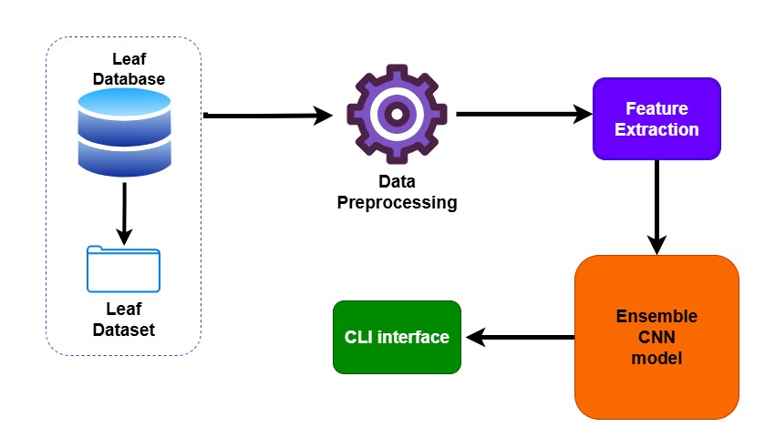
System Architecture

Slide 14
Proposed Methodology
Module-1(Leaf Database)
Module-2(Data Preprocessing)
Module-3 (Feature Extraction)
Module-4. Ensemble CNN Model
Module-5 (CLI Interface)

Slide 15
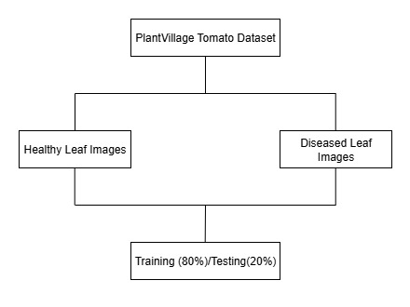
Module-1(Leaf Database)
Uses the PlantVillage Tomato dataset with ~14,000+ images.
Contains healthy and diseased leaf samples across multiple categories: Early Blight, Late Blight, Yellow Leaf Curl Virus, etc.
The dataset is split into training (80%) and testing (20%) for model evaluation.

Slide 16
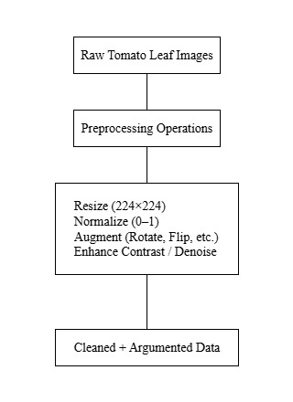
Module-2(Data Preprocessing)
Input images are resized to 224×224 pixels (to fit CNN input size).
Normalization scales pixel values (0–255 → 0–1) for faster training.
Augmentation (rotation, flipping, zoom, shift) improves model generalization.
Noise removal and contrast adjustment make disease features clearer.

Slide 17
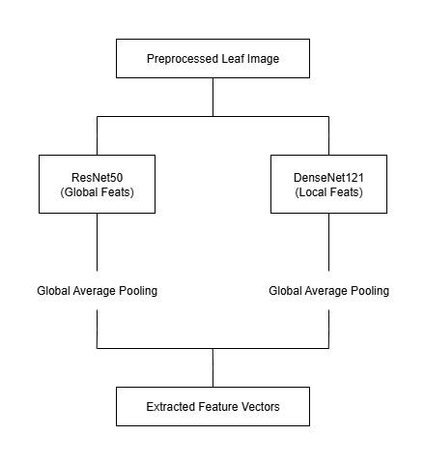
Module-3 (Feature Extraction)
Performed using pretrained CNNs (ResNet50 & DenseNet201).
Early layers capture edges and textures, deeper layers
capture disease patterns (spots, discoloration, curl).
Extracted features are high-dimensional vectors passed to the classifier.

Slide 18
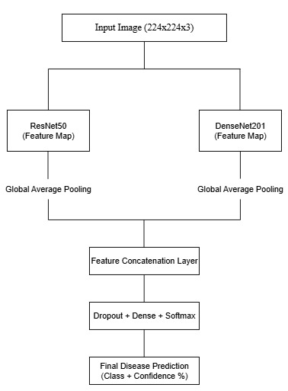
Module-4. Ensemble CNN Model
Combines the predictions of ResNet50 and DenseNet201.
Uses confidence-based weighted voting to finalize the disease class.
Achieves higher robustness and accuracy (99.8%) compared to a single CNN.

Slide 19
Module-5 (CLI Interface)
Provides a Command-Line Interface for image input.
Farmer/extension worker runs:
python detect.py --image tomato_leaf.jpg
Output shows:
Disease name (e.g., Early Blight)
Confidence score (e.g., 97.5%)
Suggested treatment (e.g., Fungicide recommendation).
Works offline, making it suitable for rural use.

Slide 20
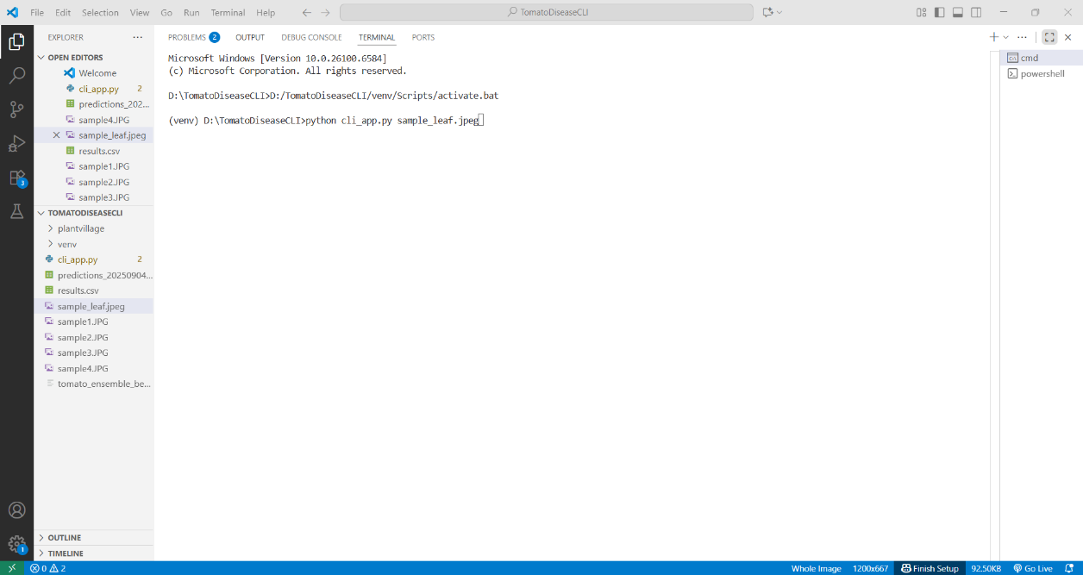
Result

Slide 21
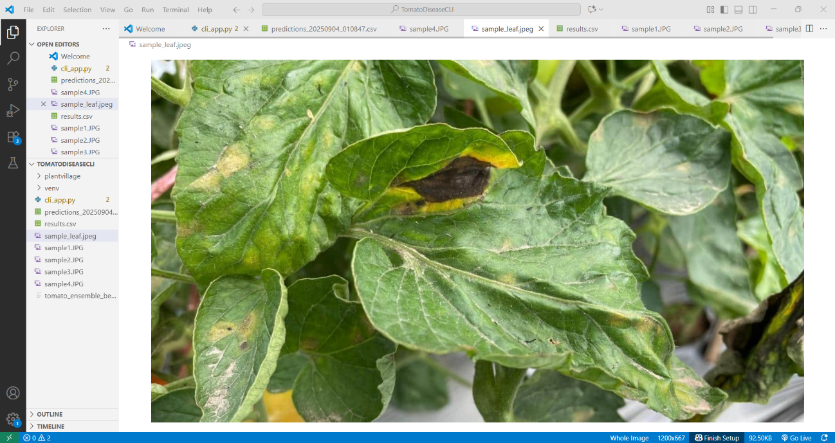

Slide 22
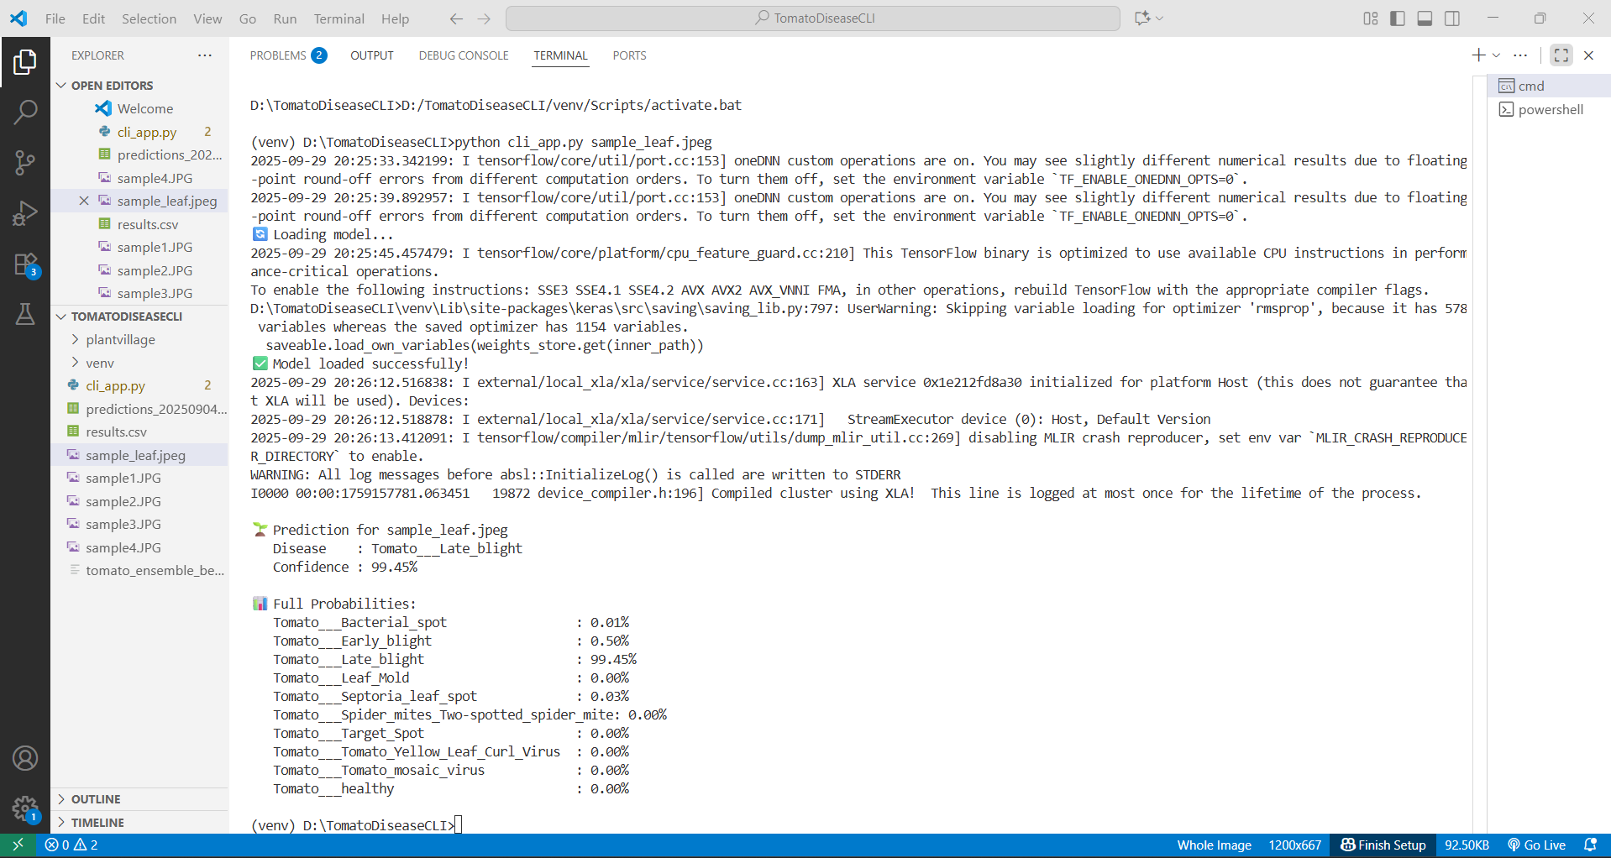

Slide 23
Conclusion
This study presents an effective offline tomato leaf disease detection system that utilizes ResNet50 and DenseNet201, achieving a high accuracy of 99.97% on the PlantVillage dataset. By combining ensemble deep learning with a confidence-based method, the system provides reliable disease detection while remaining accessible in rural areas with limited internet connectivity. It supports early identification of leaf diseases, helping reduce crop losses and unnecessary pesticide use. Furthermore, the system contributes to the United Nations Sustainable Development Goals by promoting zero hunger (SDG2) and encouraging responsible consumption and production (SDG 12).

Slide 24
Future Enhancements
Future improvements include expanding the system to support more crops like rice, banana, and cotton, integrating low-cost cameras for real-time field monitoring, and testing with actual field images to handle variable lighting and backgrounds. Developing user-friendly, multilingual applications and collaborating with NGOs and agricultural experts will make the system more accessible and widely deployable in rural areas.

